Slide 1

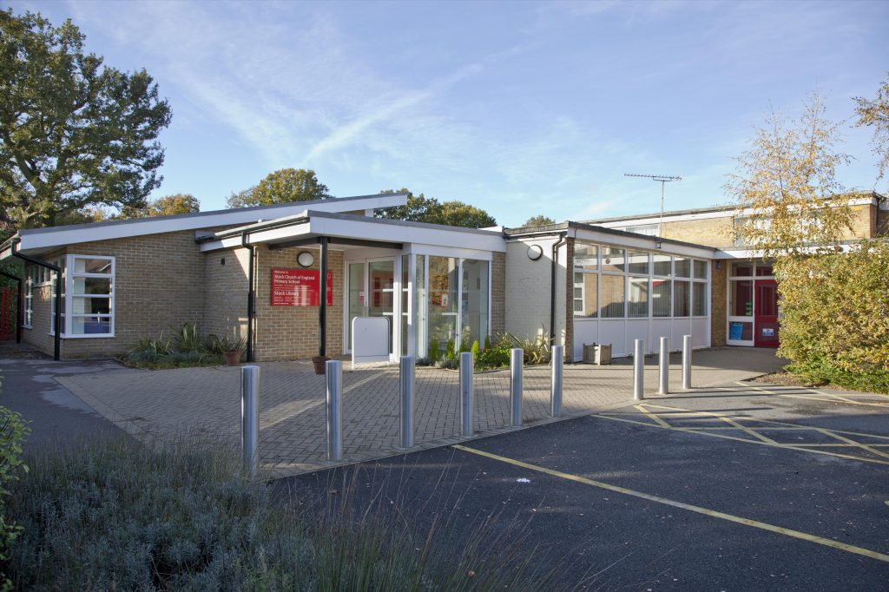
Welcome to Stock C of E Primary
School SEND Information Report
Swan Lane, Stock, CM4 9BQ
This SEND Information Report has been written to give parents and young people any advice they feel they may need.
Any questions, please get in touch.
Written and reviewed 2025

Slide 2
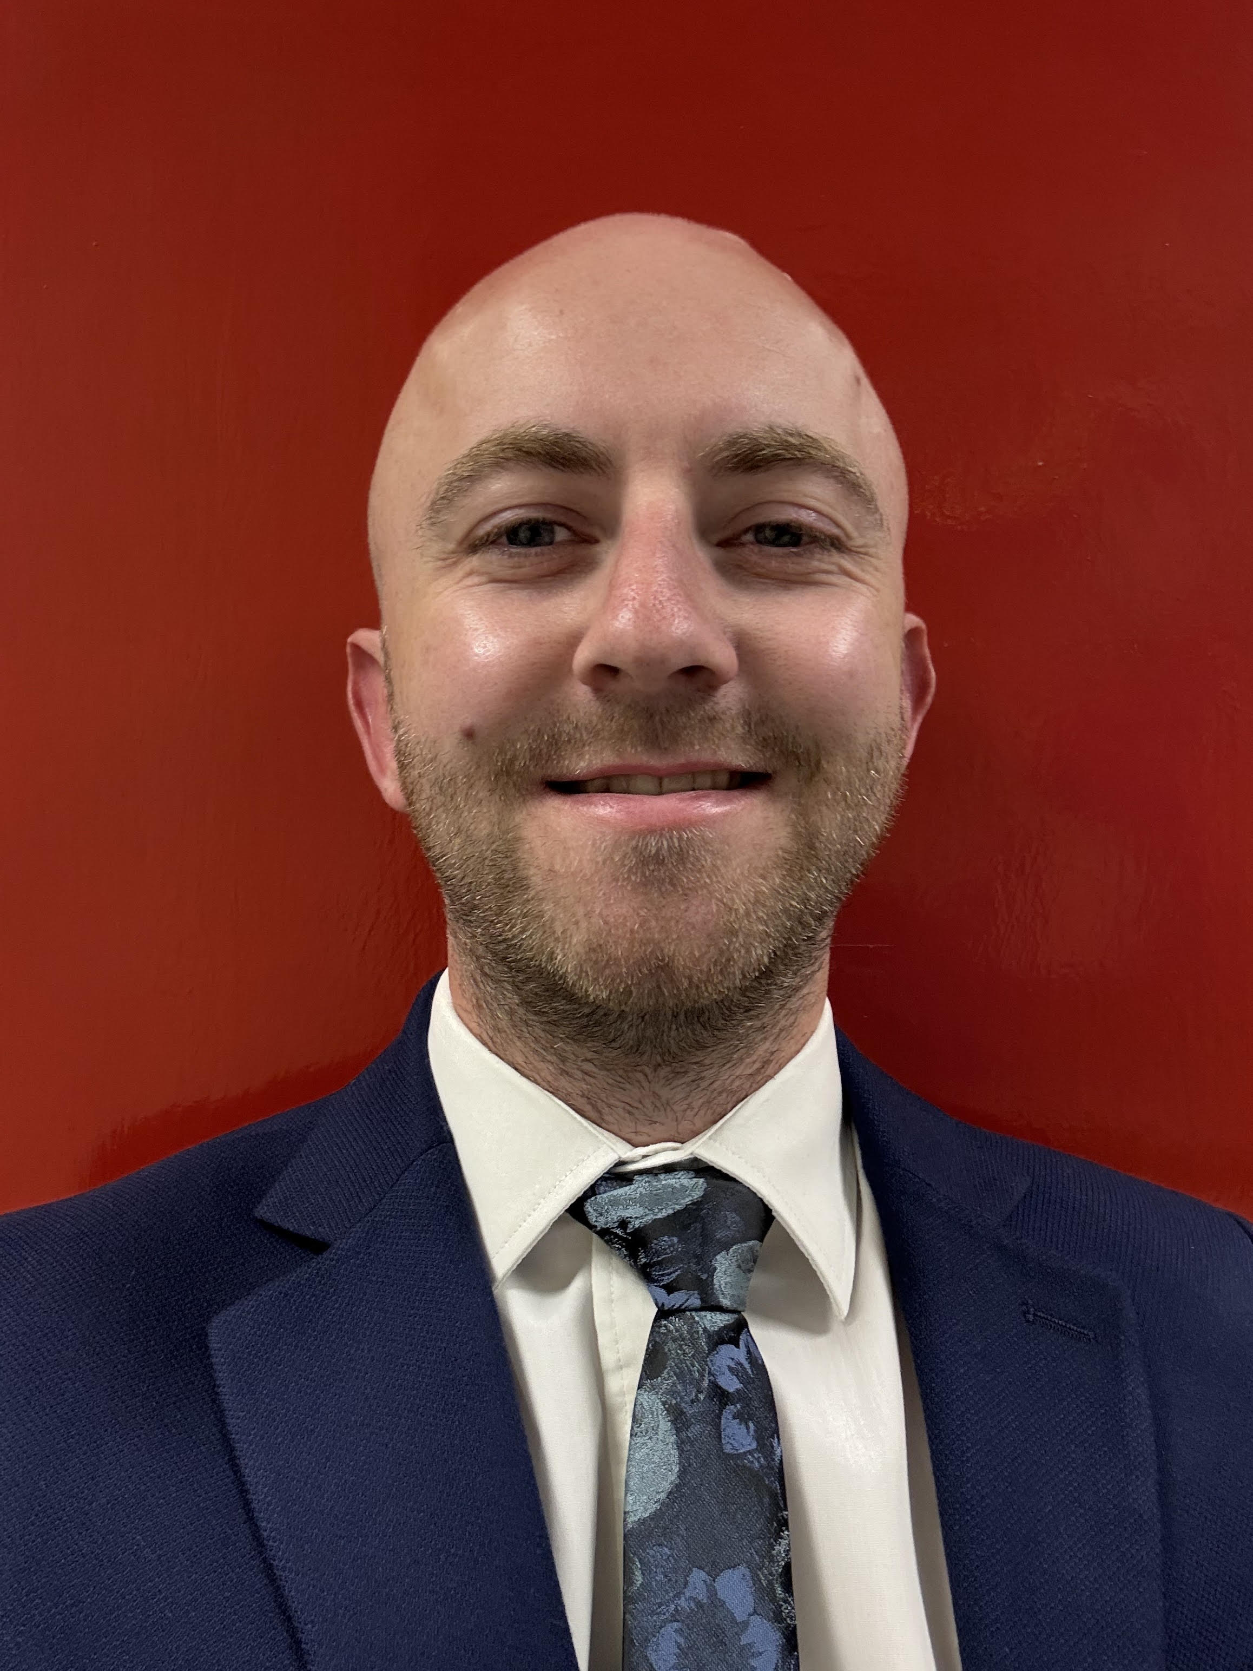
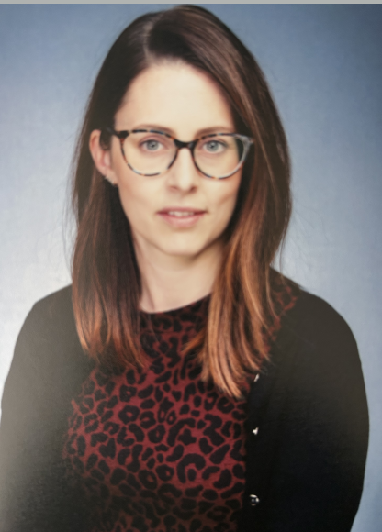
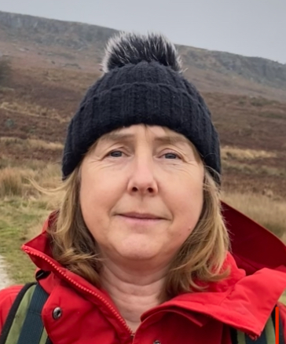
Key People
Whilst all teachers are teachers of SEN, the people listed below may be key contacts.
Gareth Roberts Head teacher How to get in touch: 01277 840265 admin@stock.essex.sch.uk | Louise Blaber SENCO How to get in touch: 01277 840265 senco@stockessex.co.uk | Jo Oldfield SEN Governor How to get in touch: admin@stock.essex.sch.uk

Slide 3
What can you find in this report?
School Ethos | What kind of interventions might my child access?
Who is part of the SEN team? | Who might support my child?
How is need identified? | What if my child has a medical need?
Which services could we refer to? | Contacting the SENCO
What kinds of SEND are provided for? | Governance policies
How do we consult with parents of children with SEND? | Voluntary and external bodies
How are One Plans formed and monitored? | Complaints
How do we give children a voice? | External support
What is our approach to the curriculum?

Slide 4
Our School Ethos
We aim to create a happy, caring community where everyone feels valued and secure. We value the contributions made by all children, professionals and parents to help enhance and maintain our inclusive school community. We appreciate and value the best efforts of every child in all aspects of school life, ensuring they realise their maximum potential.
We provide a broad and balanced and stimulating curriculum for every child regardless of race, gender or ability.
At our school, we aim to promote positive learning for our children with SEND through:
Ensuring all children feel a valued part of the school
Providing a safe and supportive environment
Having access to a range of teaching and learning strategies to suit their needs
Promoting independence and resilience as a learner, without over reliance on adult support
Identifying and addressing needs to ensure early intervention
Communicating their needs appropriately throughout the school
Encouraging close links with home
Back

Slide 5
Our SEND and Inclusion Vision
At Stock C of E Primary School, we believe every child is unique, valued and full of potential. Guided by our vision, “Let Their Light Shine,” we are committed to creating a nurturing, inclusive and inspiring environment where all children — including those with Special Educational Needs and Disabilities (SEND) — feel safe, respected and empowered to thrive.
Through our values of Affinity, Aspire and Achieve, we celebrate diversity and ensure that every child is known, understood and supported as an individual.
Affinity – We foster a culture of belonging where every child and family is welcomed, valued and included. We build strong relationships based our gospel values of: Trust, kindness, compassion, koinonia, perseverance, thankfulness and justice we help children develop confidence, independence and positive self-worth.
Aspire – We encourage every child to believe in themselves and aim high. By recognising strengths, nurturing talents and removing barriers to learning, we create opportunities for all pupils to grow academically, socially and emotionally.
Achieve – We are committed to enabling every child to experience success and make meaningful progress from their individual starting points. Through high expectations, inclusive practice and personalised support, we ensure that all learners can flourish and reach their full potential.
Together, we strive to create a community where differences are celebrated, every voice is heard and every child is given the opportunity to shine brightly
Back

Slide 6
Identification of need
“Every teacher is a teacher of SEND”
At Stock C of E Primary school, we wholeheartedly believe this. All children will receive Quality First Teaching within their class. This is inclusive teaching . It may be identified that a child is not making expected progress with Quality First Teaching.
Children may be having difficulties with their learning and/or behaviour – if this is the case, then parents will be informed. Staff and parents will work with the SENCO to put in place a plan of action.
If parents have concerns at home, they are welcome to come and discuss these with the class teacher at any point.
It may be that reasonable adjustments need to be made or interventions put in place.
Back

Slide 7
Identification of need and expertise of staff
Mrs Blaber is undertaking her mandatory SENCO qualification. Class teachers and LSAs are able to participate in targeted training courses to support their teaching and understanding of different needs. Whilst it is not the school’s role or practice to diagnose, staff may identify that a need for referrals to external services such as:
Paediatrics – ASD and ADHD assessments
The School nurse
Occupational therapy
Wellbeing support via the School Nurse
Counselling – Brentwood Catholic Children’s Society/Yo-yo projects
Hearing/vision checks (these will need to be arranged by parents)
Speech and language
Physiotherapy
You may come under Provide or NELFT for such services, depending on area of residence.
Back

Slide 8
What kind of SEND needs are provided for?
The SEND Code of practice identifies four broad areas of need.
Communication and interactions
“Children and young people with speech, language and communication needs (SLCN) have difficulty in communicating with others.”
This may include children with speech and language difficulties, difficulties processing language but also children with ASD.
Cognition and Learning
“Support for learning difficulties may be required when children and young people learn at a slower pace than their peers, even with appropriate differentiation.”
This may include mild and moderate learning difficulties but also specific learning difficulties such as dyslexia and dyscalculia.
Social, emotional and mental health
“Children and young people may experience a wide range of social and emotional difficulties which manifest themselves in many ways. These may include becoming withdrawn or isolated, as well as displaying challenging, disruptive or disturbing behaviour.”
This may include children struggling with anxiety but also ADHD or attachment disorders.
Sensory and/or physical need
“Some children and young people require special educational provision because they have a disability which prevents or hinders them from making use of the educational facilities generally provided.”
Some physical disabilities are related to age others will not change over time. The may include hearing or visual impairment and may require on going support and equipment.
Back

Slide 9
Arrangements for consulting parents of children with SEND
We appreciate and encourage support from parents in their child’s education and firmly believe that home and school should work in partnership. We have an “"open-door"” approach where parents are encouraged to maintain close communication links with school staff. Should you have any concerns please do not hesitate to get in touch with either your class teacher using the year group e-mail address, or the SENCO.
All parents or carers with children with SEND are invited to termly review meetings to be involved in planning and reviewing their children’s targets and progress. The meetings take place with the class teacher and/or Special Educational Needs Co-ordinator (SENCO). We encourage both parents and children to share their views and contribute to the One Plan or EHCP review.
Back

Slide 10
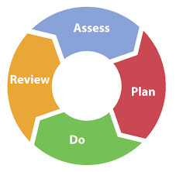
Arrangements for consulting parents of Children with SEND
Our One Plans (individual education plans) follow a graduated approach.
Assess: Assess where the children currently are using age and stage appropriate assessments.
Plan: Set SMART targets which will support children to meet an overall outcome.
Do: Implement these targets over a term, using targeted interventions as well as Quality First Teaching to support learning.
Review: Meet with class teachers termly to review progress towards outcomes and consider what the next steps might be.
Parents will be offered three One Plan or EHCP review meetings over the course of the year. EHCPs will also have an annual review. If additional meetings are required then these can be offered.
CEM.ORG
Back

Slide 11

Arrangements for informing and involving young people in their education.
As part of our One Planning cycle, children will be asked to contribute their ideas and share their hopes and aspirations. As they get older they will play a greater part in discussing their outcomes.
Children can also share their ideas via the school council.
Back

Slide 12
Approach to teaching
All staff are trained in the principals of Quality First Teaching.
Staff will refer to ordinarily available framework as well as applying targeted support.
In class, many adaptations can be applied to support your child, such as:
Visual cues
Additional scaffolds, pre-teaching, provision of vocabulary prior to teaching or pre-assessment
Provision of additional resources such as laptops, coloured overlays, visual timetables.
Use of wobble cushions and therabands.
Additional sensory breaks, writing slopes etc may be advised by outside agencies and can be supported in class.
Working on specific evidence-based interventions.
Back

Slide 13
Adaptations to the curriculum
As children progress through the school all areas of the curriculum can be adapted to meet their needs, whether that need is physical, communication and language related or cognitive. Our teachers make adaptations which are appropriate to the children in their care.
When appropriate or required your child may also participate in targeted interventions.
Back

Slide 14
Our Interventions
Toe By Toe | Toe By Toe is a highly structured multi-sensory phonetic approach to Literacy. It is designed for anyone who finds reading difficult. This includes readers who struggle to decode or those with dyslexic type difficulties.
Precision Teaching | Precision Teaching enables children to hone their key skills by engaging in short, focused tasks on a regular basis. We use a multi-sensory approach to teach reading, spelling and number skills.
Developing Focus and Attention | This is a program developed by Essex County Council which aims at developing the period of time young children are able to focus for.
The Five Minute Box | For Reception age children, this is an intervention which builds on our literacy and numeracy skills using activities which only take five minutes to complete.
Lego therapy | Lego-based therapy aims to develop social communication skills in children who have difficulties with sharing, turn-taking, following rules, using names and problem-solving. In practice, children work in groups of three with each participant having a distinct role to build a Lego model collaboratively.
Hertfordshire Reading | Our Reading Fluency Project works to significantly improve outcomes for pupils and is designed to help equip teachers to improve fluency and comprehension.
Little Wandles Catch Up | Our children work in small groups to work rapidly through phonics activities which are appropriate for their stage.
Maths Stacks | Number Stacks uses a combination of stackable place-value counters and video tutorials to help children master the foundations of the number system. With support from the teaching assistant our pupils are able revisit areas of the maths curriculum that they have not yet managed to develop fluency in.
EPS Maths
Back

Slide 15
How will Stock C of E support my child when they join the school?
Contact is made to arrange a meeting once a school placement has been confirmed.
If children have an identified need, or a concern about need has been raised, a meeting may be arranged between the SENCO, reception teacher, pre-school staff and parents to ensure a smooth transition.
SENCO and relevant staff visit pre-school settings of children with complex needs and liaise with key workers.
Children will join us for transition sessions in the summer term where they will meet all staff who they will work with in the next school year.
Back

Slide 16
How will Stock C of E support my child when they move between classes and key stages?
EYFS teachers prepare for the transition of pupils to Year 1 at an appropriate point at the end of Foundation Stage.
All children will have a ‘Meet the Teacher’ session with their new class teacher and any additional staff working with them.
At the end of each year, teachers liaise carefully to ensure continuity for all children, but especially children with additional needs.
Children with additional needs may have additional transition sessions with staff who they will work closely with the following year.
Children may be provided with Social Stories to provide them a point of reference for over the summer.
Back

Slide 17
How will Stock C of E support my child when they transition to secondary school?
SENCOs and key staff from Secondary Schools visit or request a report from the school to discuss pupil needs.
They are also invited to attend Year 5 and/or Year 6 Annual Reviews.
Some Secondary Schools arrange additional transition visits for pupils with SEND. Copies of essential paperwork are transferred to the Secondary School.
Information regarding the special educational needs of Looked After children is reported to the placing Local Authority on a termly basis.

Slide 18
Evaluating the effectiveness of provision
Children’s One Plans are assessed on a termly basis, as part of our graduated approach. All children will undertake termly assessments, the tests that are used for assessment may be taken from a different year group if this is appropriate.
The effectiveness of interventions and adaptations is also carefully monitored to ensure that they are the most appropriate intervention.
Staff assess data from these interventions to ensure that children are given the most effective provision possible. Some interventions will be used for a short period of time. Others will be ongoing.
Back

Slide 19
Emotional and social development
At Stock we will also work on building children’s resilience and help them to build friendships and have several intervention groups which support this.
If your child has a SEMH need we are able to refer to several outside agencies for additional support.
EWMHS – wellbeing support
Kids Inspire
The Wilderness Foundation
Brentwood Catholic Children’s Society.
Your GP or school can put you in contact with CAHMS.
If your child is in crisis contact: 0800 953 0222 or at the weekends/bank holidays: 0800 995 1000. In an emergency or if there is immediate danger to life please contact 999 or go to A and E.
Back

Slide 20
Who might support my child?
Within the school we have a number of LSAs who may work to support your child on a 1:1, small group or whole class basis.
External agencies may come in to work with your child. If this happens you will be informed.
They may work with a 1:1 tutor when they are in year six.
Back

Slide 21
What if a child has a medical need?
If your child has a medical need the school must be informed.
If your child has a complex medical need, they may need a comprehensive care plan. This will be shared with all staff.
If your child needs medicine within the school day, the office will need to be informed and a form must be completed.
Back

Slide 22
How does the school involve other bodies, LA support, voluntary organisations?
We work with a wide range of professionals including:
Educational Psychologists
Occupational therapists
Speech and language therapists
CAMHS
The Autism Outreach Service
We can also work with or refer to charities and external agencies such as:
Snap
Kids Inspire
Essex Therapy Dogs
Young Carers
The Yo-Yo project
Brentwood Catholic Children’s Society
Back

Slide 23
Contacting the SENCO
The school SENCO is Mrs Louise Blaber.
Mrs Blaber has been at Stock Primary School since January 2023 and began her role as SENCO in September 2024. She is undertaking the mandatory training and will complete this in April 2025. (NPQSENCO)
She meets with senior staff, teachers, LSA’s, families, pupils, governors and other professionals. She identifies training needs and opportunities and monitors the quality and impact of interventions. She works closely with the Local Authority through regular meetings and contact with the school’s Inclusion Partner.
She works two days a week in capacity as SENCO, usually Tuesday and Wednesday, and is contactable in person through the school office, by phone or by email. She is also in class in Year 2 on a Friday. Any concerns raised will be dealt with as quickly as possible.
01277 840265
Senco@stockessex.co.uk
Please get in touch with any concerns.
Back

Slide 24
Governance and Policies
There is a SEND Governor whose role is to regularly support and challenge provision for SEND pupils. The SEN Governor and SENCO meet to discuss provision. The SEND Governor reports back to the Governing Body which has a representation of parent Governors.
Relevant policies, including the SEND Policy, are available from the school website – paper copies can be obtained on request via the school office.
The school accessibility plan is reviewed regularly to ensure the school building is fully accessible and well maintained.
Back

Slide 25
Complaints
Governing body arrangements for complaints from parents of pupils with special educational needs.
The school has an “"open-door"” policy. We aim to resolve issues swiftly and in person, hoping to reach a mutual agreement and understanding.
A parent’s first port of call is to arrange for a meeting with the class teacher.
If necessary or appropriate, they would then go to the SENCO, after which, the matter progresses to the Headteacher
In the unlikely event that the matter is not concluded, the Complaints procedure can be read on the school website, or a copy can be obtained from the School Office on request.
Back

Slide 26






Where else can I find access support?
Essex Local Offer
SNAP
Kids Inspire
SENDIAS
Families in Focus
Autism Central
Back

Slide 27
Glossary of terms
ASD – Autism Spectrum Disorder
ADHD – Attention Deficit Hyperactivity Disorder
CAMHS – Child and adolescent mental health services
EHCP – Educational Health Care Plan, this is a plan which documents exactly what provision should be in place for a child with additional needs.
One Plan – an individual education plan to support the needs of a child.
SEND – Special education needs and disabilities
SENCO – The Special Educational Needs Co-Ordinator within the school.
SLT – Speech and language therapy
Quality First Teaching – Inclusive teaching practises which should be present in every primary classroom.
Back

